Slide 1

Jabra Enterprise software solution for Voice Responsible
A fully integrated online solution
Stefan Heise – Jan 2016

Slide 2

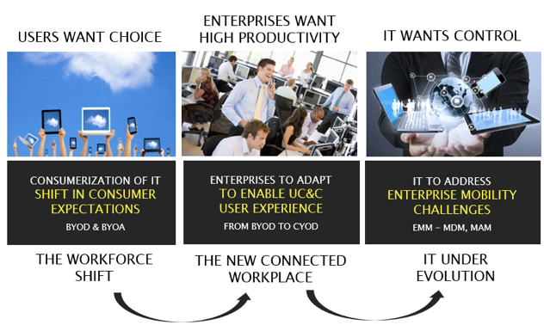

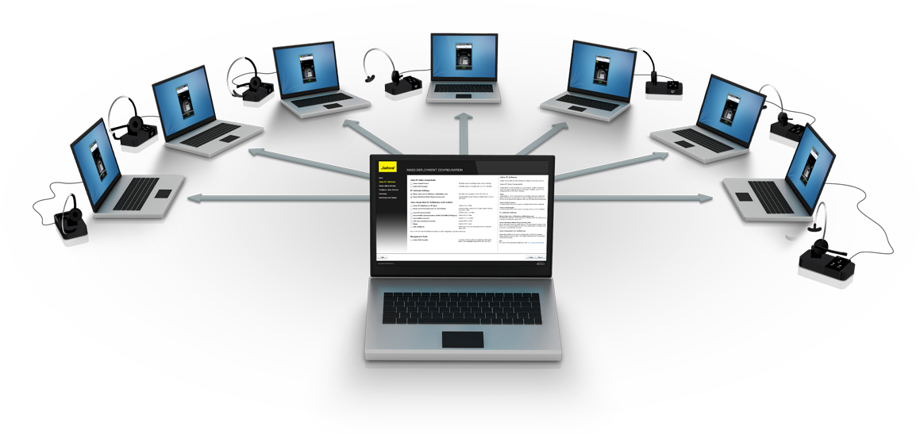





Index
1
2
Market Insights
Where Are Jabra Xpress Business Opportunities?
3
What Is Jabra Xpress?
4
How Does Jabra Xpress Really Work?
Market Insights & Trends
Setting the Scene
5
Hands-on
6
7
Jabra Partners Business Opportunity Elevator Pitches
Marketing Go-to-market Recommendation & Deliverables

Slide 3
MARKET INSIGHTS & TRENDS
USERS WANT CHOICE The workforce shift
ENTERPRISES WANT HIGH PRODUCTIVITY The new connected workplace
IT WANT CONTROL IT under evolution

Slide 4
WHERE ARE JABRA XPRESS BUSINESS OPPORTUNITIES?
Enterprises focus on ENHANCED USER EXPERIENCE
Enterprises invest in UC&C SOLUTIONS
IT needs to CONTROL mobile devices
IT needs solutions to gain HIGHER EFFICIENCY

Slide 5

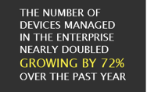
ITDM HAVE HIGH FOCUS ON ENTERPRISE MOBILITY MANAGEMENT
DEVICES & APPS PROLIFERATION
Loosing control of devices
IT Support has a growing workload
IT NEEDS
To focus on Data Security - Technology Compliancy – End User experience - UCC costs
To initiate new measures to regain control & gain higher efficiency
IT INVESTS IN RESOURCES & TOOLS

Slide 6
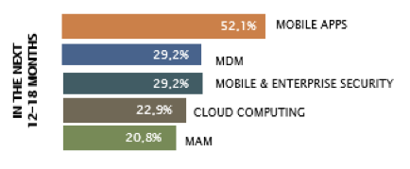
IT BUDGET IMPACTED WITH INVESTMENTS IN UC&C SOLUTIONS & ENTERPRISE MOBILITY
33%
69%
of ITDMs expect to increase their budget for mobile-related products by 5% in the next 12 mounts
of organizations expect their UC&C budget to increase
DRIVERS TO INVEST IN UC&C SOLUTIONS
43%
ENHANCED EMPLOYEE COLLABORATION
ENHANCED EMPLOYEE PRODUCTIVITY
INCREASED EMPLOYEES’
FLEXIBILITY
ENHANCED MOBILE
WORKFORCE MOBILITY
42%
33%
Source: EnterpriseMobilityExchange_AnnualReport_2014-2015, Enterprise Mobility Exchange
33%
Source: 2015 Unified Communications & Collaboration (UC&C) study, IDG Enterprise, July 2015

Slide 7
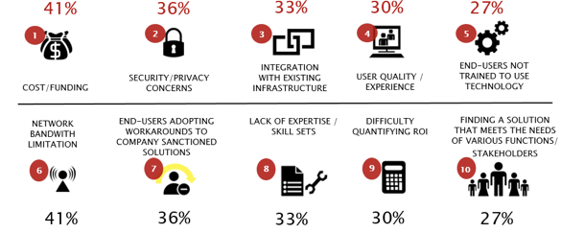
JABRA XPRESS CAN ADDRESS SPECIFIC IT CHALLENGES
Global ITDMs’ top challenges to implement UC&C solutions

Slide 8
JABRA XPRESS CAN MEET GLOBAL LEADERS’ EXPECTATIONS WHILE CHOOSING AN ENTERPRISE SOLUTION
GLOBAL CIO & CEO - TOP CRITERIA TO CHOOSE AN ENTERPRISE SOLUTION PROVIDER
52.1%
FITS IN MY LONG-TERM MOBILITY STRATEGY
41.7%
WITHIN BUDGET
47.9%
35.4%
COMPLIANT WITH REGULARTIONS
EASY OF USE
47.9%
20.8%
EASE OF INTEGRATION
HAS REFERENCES
45.8%
SOLVES THE SPECIFIC PROBLEM I WANT
2.1%
OTHER
Source: EnterpriseMobilityExchange_AnnualReport_2014-2015, Enterprise Mobility Exchange

Slide 9
TAKE AWAY
THE GROWING NUMBER OF DEVICES AND APPS IN ENTERPRISE CREATES CHALLENGES
ORGANIZATIONS NEED TO TURN TO MANAGEMENT TOOLS TO…
Too many mobile devices
Too many apps
Too many operating systems
Too many vendors
Regain control of users’ devices
Simplify IT administrator tasks
Enhance employees’ user experience
… AND TOO LITTLE RESOURCES AND TIME
… ACCELERATE UNIFIED COMMUNICATIONS ADOPTION

Slide 10

HOW CAN JABRA HELP IT ADMINISTRATORS?
WITH JABRA XPRESS
MASS DEPLOYMENT OF HEADSETS MADE FAST & EASY
Simplify audio device management tasks
Give greater control over Jabra audio devices
Help improve efficiency

Slide 11


WHO IS JABRA XPRESS DESIGNED FOR?
TARGET AUDIENCE
50+
USB
PC
-BASED
TELEPHONY
HEADSET
USERS
HEADSETS
FROM JABRA
ENTERPRISE WITH LARGE IT DEPARTMENTS & CALL CENTERS EQUIPPED WITH JABRA USB HEADSETS INCL.:
COMPANIES WITH LARGE DESK-CENTRIC USERS
& heavy Jabra headset users
Dedicated resources to voice/headsets management
Dedicated resources to UC/CC projects understanding the value of headsets
TAKE AWAY: FOCUS ON JABRA-HEAVY CUSTOMERS WHERE HEADSETS ARE BUSINESS CRITICAL

Slide 12

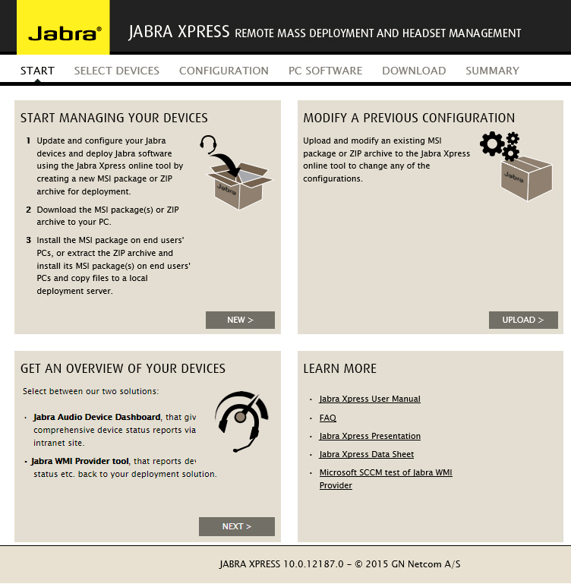
WHAT DOES JABRA XPRESS? SIMPLIFY & ACCELERATE
Jabra Xpress™ offers IT administrators a set of tools to manage every Jabra USB device on their network – all from a single Management System.
JABRA XPRESS SERVICES ENSURE
EASY DEPLOYMENT
SMART ASSET MANAGEMENT
AGILE MAINTENANCE
2X DEPLOYMENT OPTIONS BASED ON STANDARD MS TECHNOLOGY:
JABRA WMI PROVIDER TOOL – Comprehensive overview of all Jabra devices (diagnostics status)
NEW! JABRA AUDIO DEVICE DASHBOARD - a real lifecycle management tool to populate status reports, devices inventory, forecasts…
JABRA DEVICE UPDATER – to enable setting standardization and group-level configuration , and remote update of settings & drivers
JABRA MSI FILE - classic deployment process to end-users’ PCs
NEW! JABRA ZIP ARCHIVE - local server deployment option for extra flexibility

Slide 13

JABRA XPRESS - A FULLY INTEGRATED ONLINE SOLUTION
Jabra Xpress is an online service designed for IT professionals to remotely mass deploy & manage Jabra USB audio devices in record time.
WITH A SET OF SMART TOOLS, JABRA XPRESS ENSURES:
EASY MASS DEPLOYMEMT To simplify it management tasks & accelerate UC adoption
SMART ASSET MANAGEMENT To give it greater control & help it gain higher efficiency
AGILE MAINTENANCE To enhance user satisfaction & productivity & maximize headset ROI

Slide 14

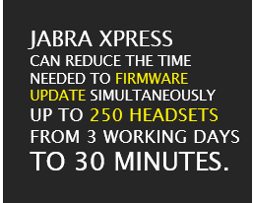
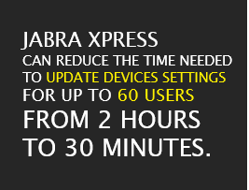
JABRA XPRESS MAXIMIZING JABRA HEADSETS’ ROI
1. MASS DEPLOYMENT
2. FIRMWARE UPDATES
3. CHANGE OF SETTINGS

Slide 15
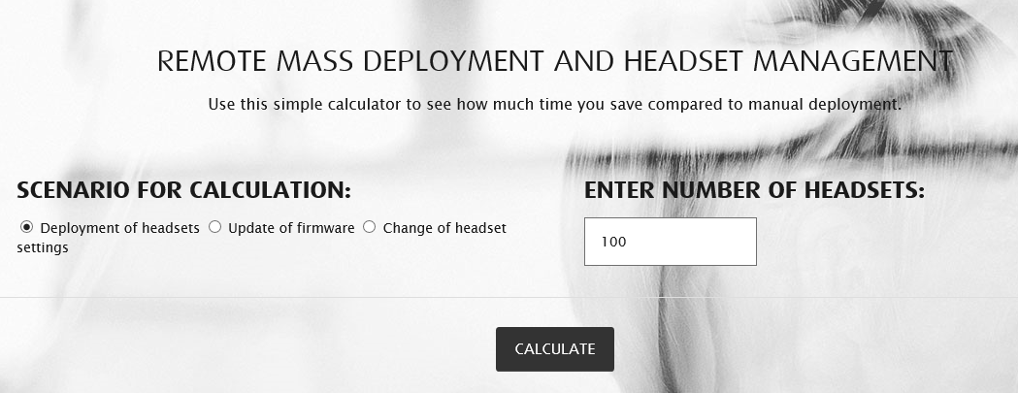
HELP YOUR CUSTOMERS CALCULATE THEIR HEADSETS’ ROI
GO TO: http://www.jabra.com/software-and-services/jabra-xpress

Slide 16
JABRA XPRESS MAGNIFIED: HOW DOES JABRA XPRESS REALLY WORK?

Slide 17







JABRA XPRESS – HOW DOES IT WORK?
Partner login at:
JABRA.COM
*MSI = Windows Installer & WMI = Windows Management Instrumentation
Request an account at:
JABRA.COM/XPRESS
JABRA SALES
NEW
SELECT JABRA XPRESS SERVICE
SMART ASSET MANAGEMENT
EASY MASS DEPLOYMEMT
AGILE MAINTENANCE
ASSET MANAGEMENT
CREATE NEW PACKAGES: Products, Settings, Firmware & Applications
UPLOAD & CHANGE PACKAGES:
Products, Settings, Firmware & Applications
NEW
NEW
Download
JABRA WMI* PROVIDER
Download
JABRA AUDIO DEVICE DASHBOARD
Download
JABRA MSI* FILE
Download
JABRA ZIP ARCHIVE for local server deployment

Slide 18
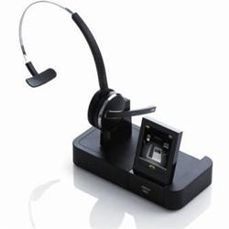
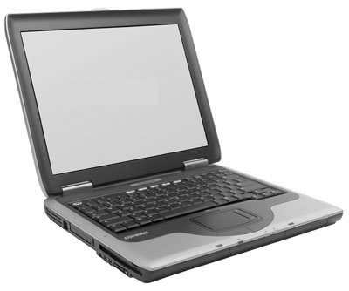
DEPLOYMENT & MAINTENANCE - FIRMWARE & SETTINGS
JABRA XPRESS
JABRA DEVICE UPDATER
Enables setting standardization & group-level configuration, and remote update of settings & drivers for:
Seamless user adoption - the right settings to the right users
Future–proof solutions - with free firmware updates
Agility – with easy change of settings to quickly adapt to any communication environment change
Devices compliancy – settings in line with corporate policies
Internet
Intranet
JDU* FIRMWARE & SETTINGS
IT ADMIN
END-USER PC & JABRA HEADSET
OR
Local file server
*JDU: Jabra Device Updater end-user PC application
FIRMWARE & SETTINGS
JDU* REGULAR POLLING TO CHECK FOR SERVER UPDATES
NEW

Slide 19

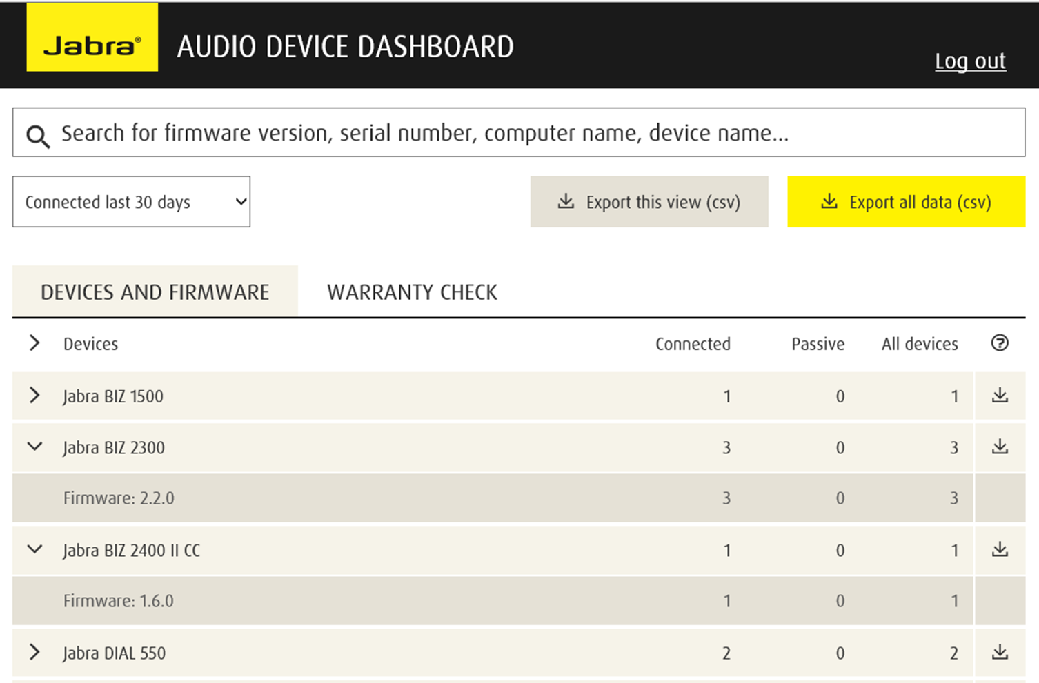
NEW – AUDIO DEVICE DASHBOARD A REAL LIFECYCLE MANAGEMENT TOOL
Populate comprehensive status reports including: device overview, firmware status and warranty check, and maximize Jabra audio devices ROI.
Reduce maintenance & inventory costs
Right-size audio devices inventory
Optimize inventory purchase decisions & forecasts
JABRA.COM
WARRANTY WEB SERVICE
Optional feature
Internet
Intranet
MS IIS
INTERNET INFORMATION SERVER
Web Service
Background
Worker
Web Site
Device Dashboard
IT Admin
Open web browser to
View Jabra Device Dashboard
DATA ACCESS
End-user PC running Jabra
Client Device Dashboard
MS SQL Server

Slide 20
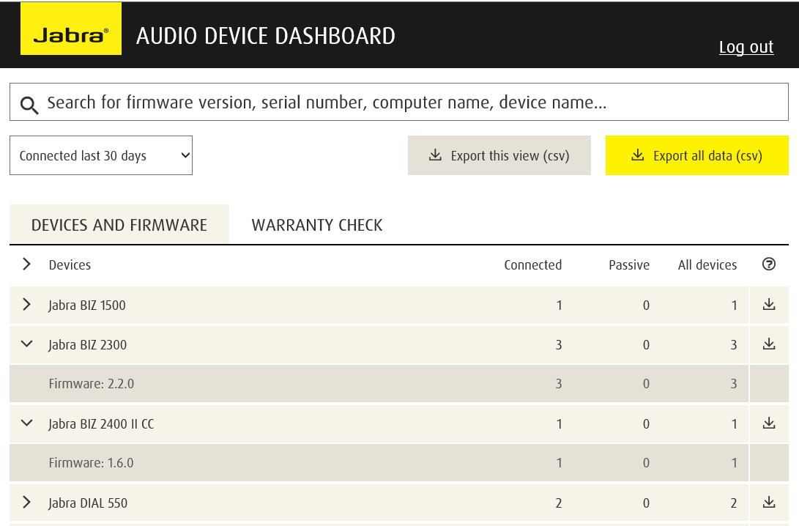
CHECK ADOPTION RATE & DEVICE STATUS

Slide 21
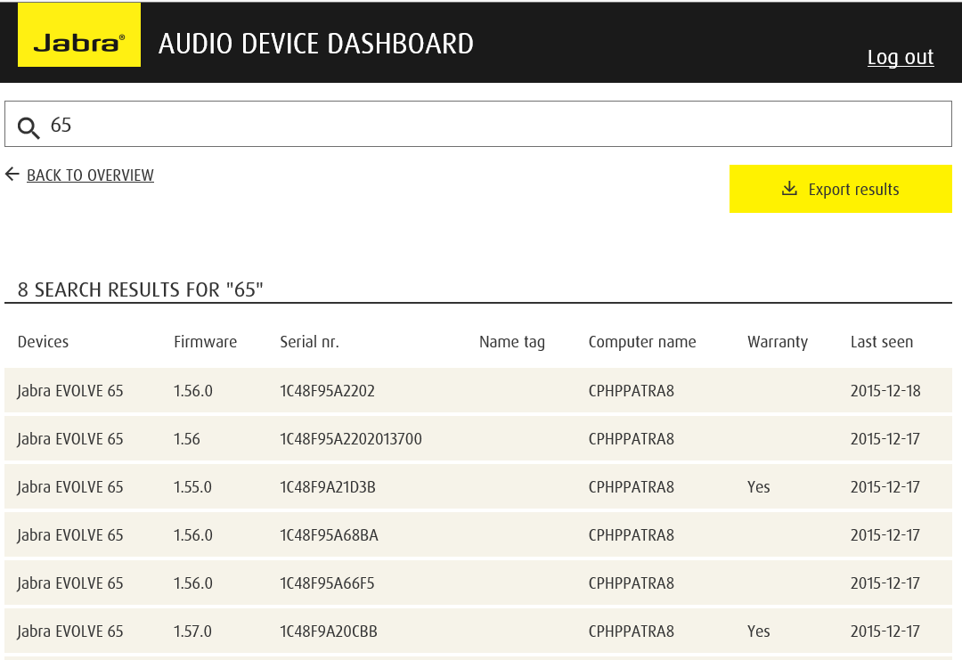
SEARCH & DEVICE SUPPORT

Slide 22
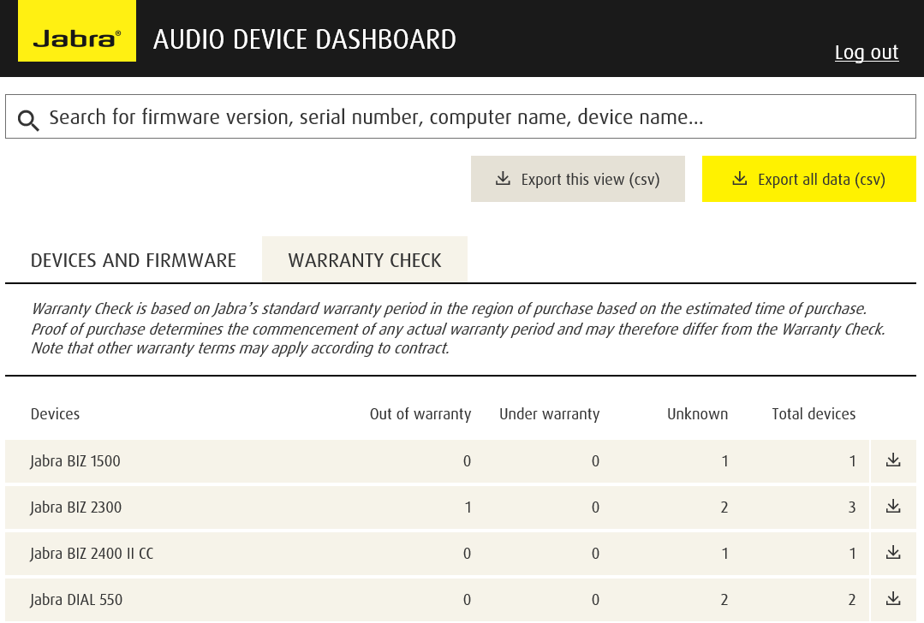
WARRANTY CHECK

Slide 23
AUDIO DEVICE DASHBOARD - DEMO WEBSITE
Link to live demo website “Audio Device Dashboard” www.jabra.com/xpress/add

Slide 24
JABRA WMI PROVIDER TOOL FULL VISIBILITY OF ALL JABRA DEVICES
Internet
Give an overview of the complete portfolio of Jabra USB devices installed on corporate IT network (E.g. Serial No, SKU No, Config time stamp, Connected status, Firmware ver. etc.)
Ensure end-user call readiness
Intranet
Install Jabra WMI provider
IT ADMIN
END USER PC & JABRA HEADSET
Deployment server
WMI script regular polling headset data from end-user PC
*JDU: Jabra Device Updater

Slide 25
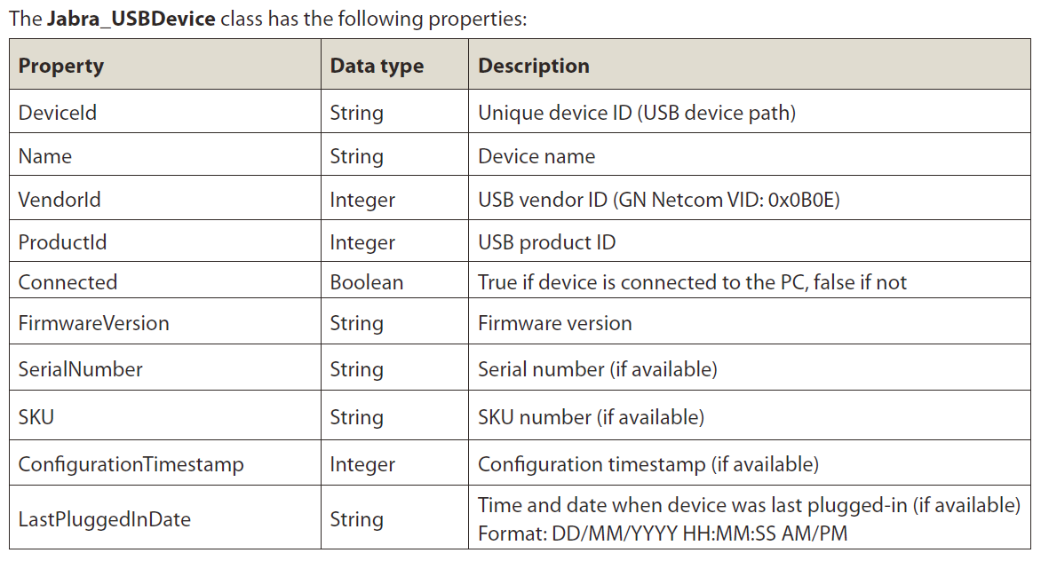
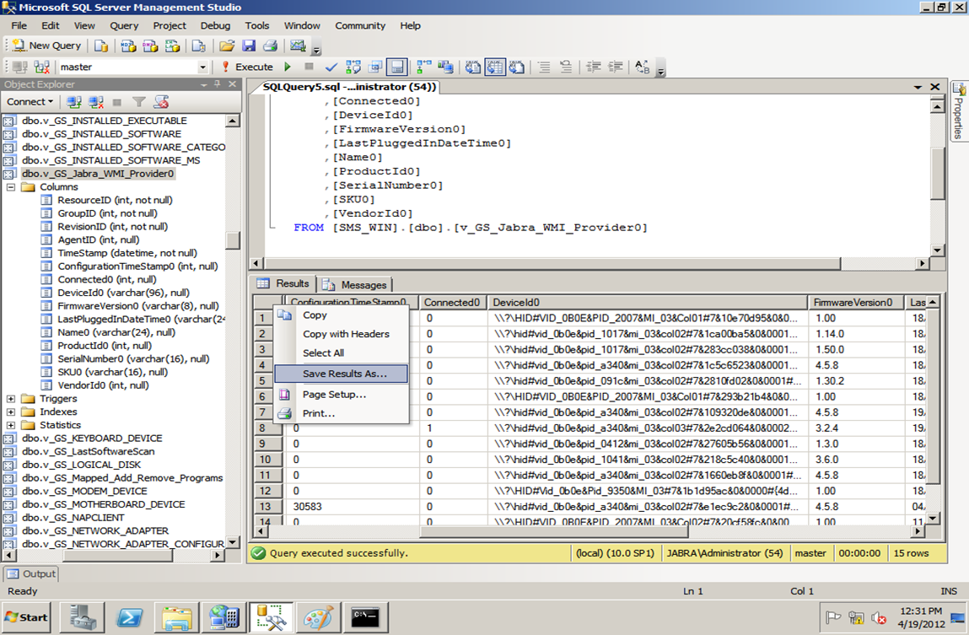
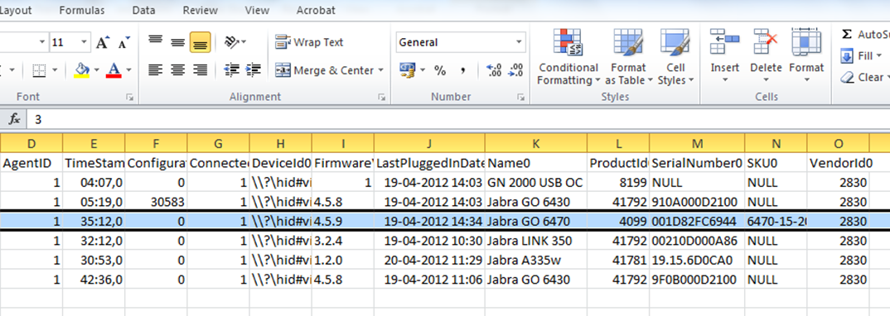
WMI product query check
*JDU: Jabra Device Updater

Slide 26
Hands on

Slide 27
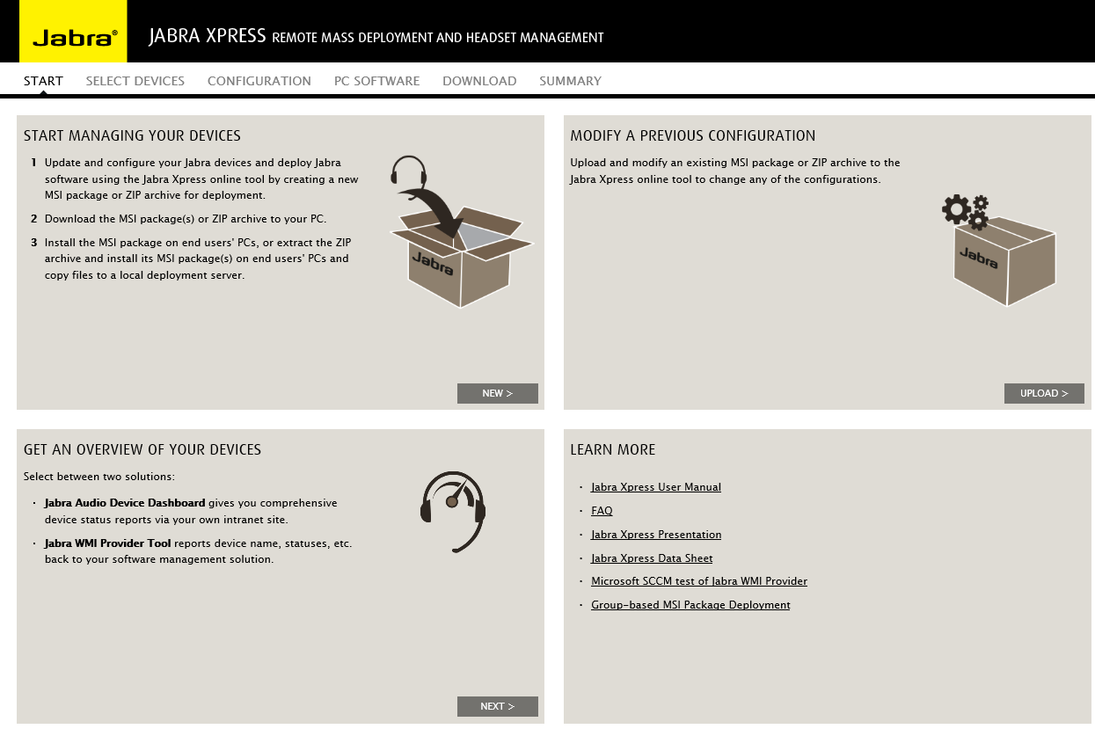
STEP #1 - SELECTION
Give an overview of the complete portfolio of Jabra USB devices installed on corporate IT network (E.g. Serial No, SKU No, Config time stamp, Connected status, Firmware ver. etc.)
Ensure end-users call readiness

Slide 28
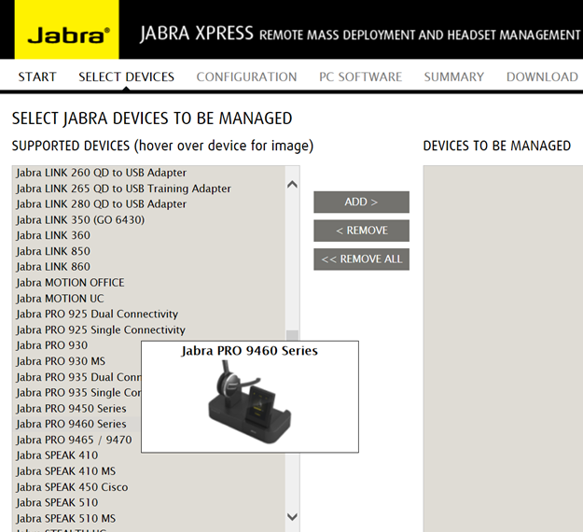
STEP #2 – PRODUCT SELECTION
Select the Jabra devices you want to remotely manage

Slide 29
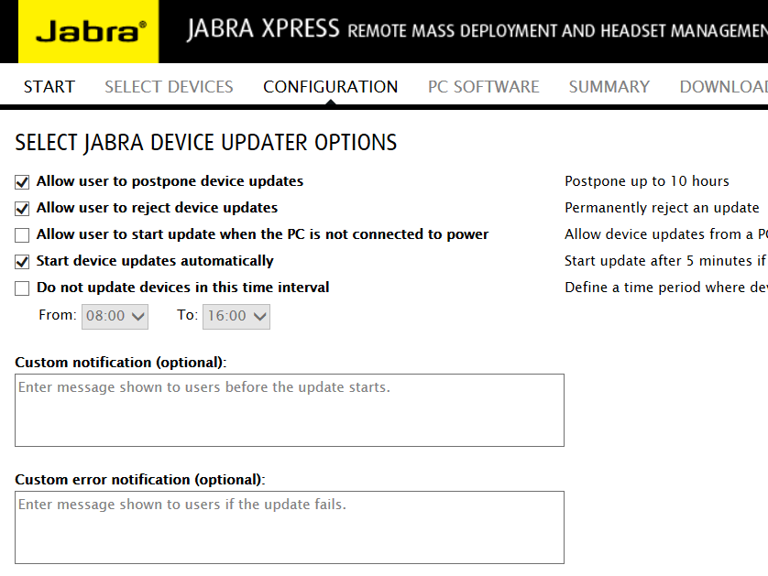
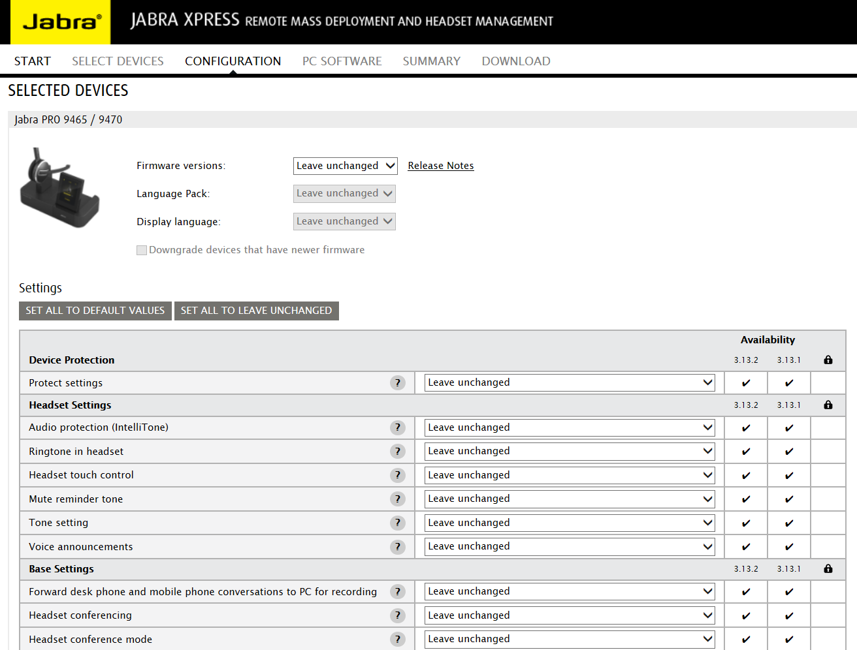
STEP #3 - DEPLOYMENT OPTIONS & CONFIGURATION
Select device firmware and settings
Set end-user parameters for MSI package
Type end-user notification

Slide 30
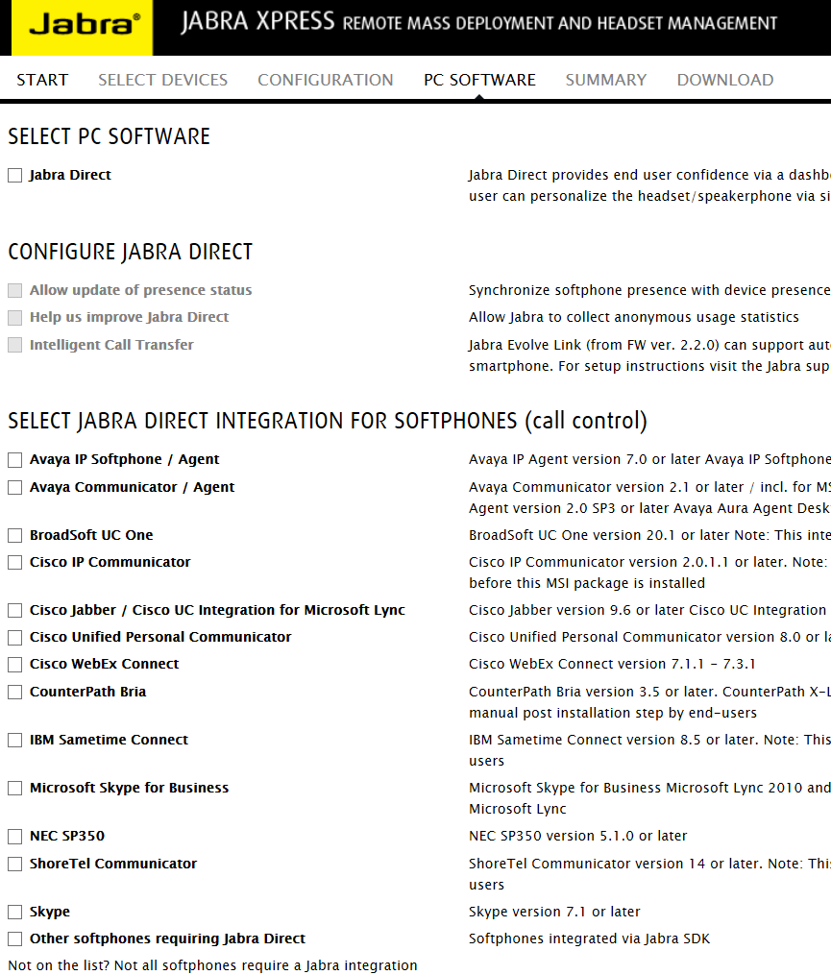
STEP #4 - SELECT SOFTWARE COMPONENTS
Select components and settings for Jabra Direct
Select softphone integration to get headset hook control with your softphone

Slide 31
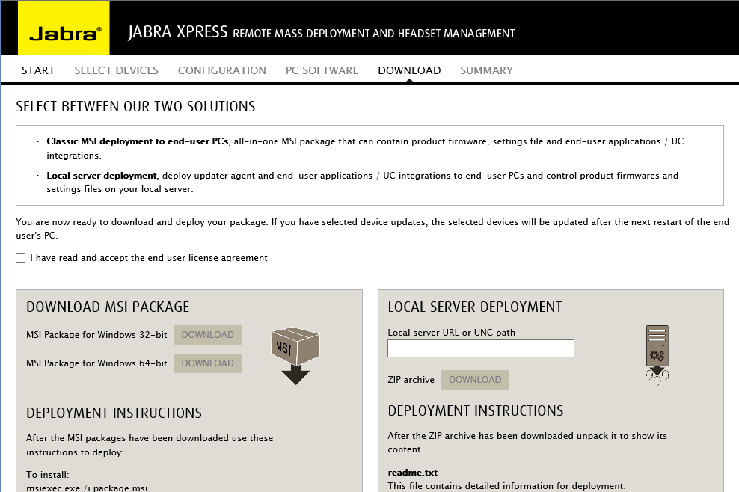
STEP #5 - SUMMARY & DOWNLOAD
Accept end-user license agreement
Select between our two solutions
Classic MSI deployment to end-user PCs
Local server deployment

Slide 32
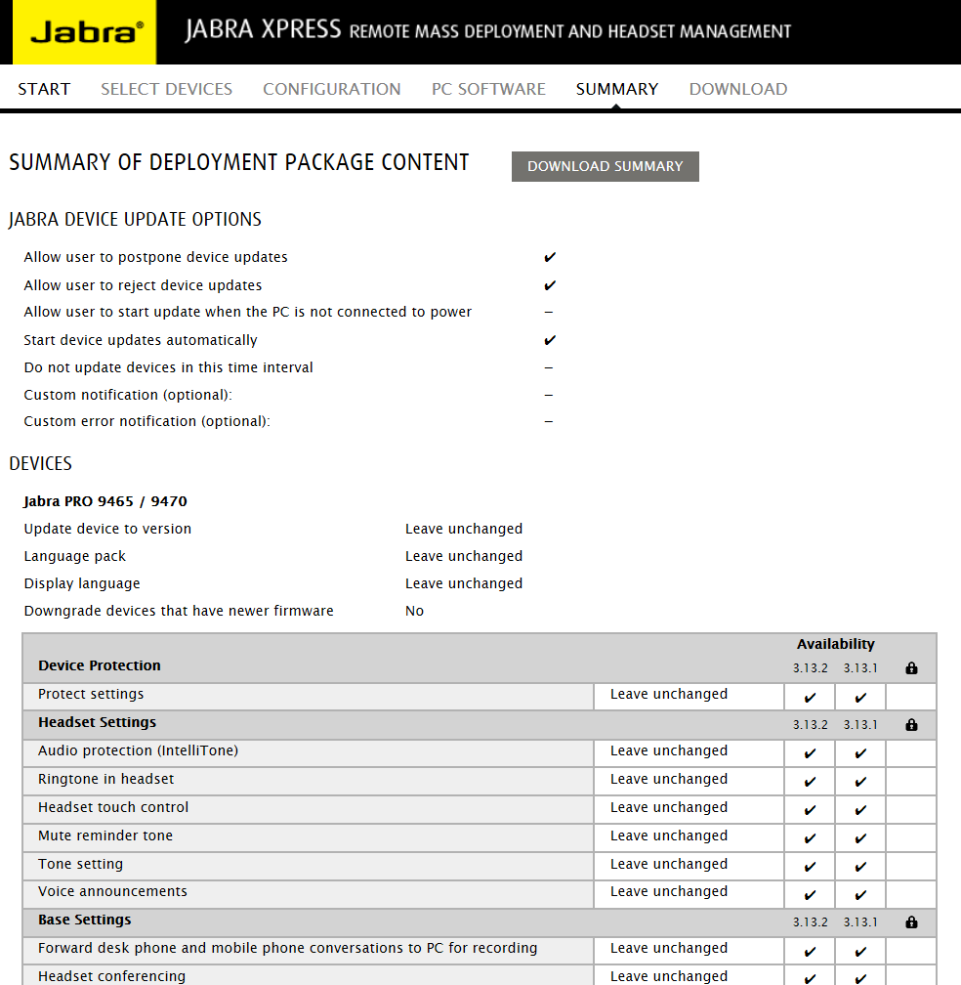
STEP #6 – SUMMARY REPORT
Review the summary of your selections

Slide 33


STEP #7 – DEPLOY THE MSI PACKAGE TO END-USER PC
Use your preferred
deployment tool. E.g.
Example of deployment tools that support MSI & WMI:
Microsoft System Center Configuration, Microsoft System Center Operations, IBM Tivoli endpoint manager, Dell KACE, Big FIX, Wyse for Windows installer, Flexera

Slide 34
INSTALLATION ON END-USER PC
END-USER PC
Jabra software can be installed on end-user PCs: • Jabra Direct components • Jabra Device Updater • Jabra WMI Provider
When Jabra Device Updater is installed, it will automatically check new connected Jabra USB devices and enforce corporate policies and legislation
Jabra MSI package can be uninstalled (zero footprint)
Jabra Direct
JABRA DEVICE UPDATER
(BACK GROUND SERVICE)
Firmware files
Configuration files
Jabra WMI Provider
or client back service for “Audio Device Dashboard”

Slide 35
SYSTEM REQUIREMENTS
END-USER PC
IT DEPLOYMENT TOOLS
Windows XP SP3 32bit, or later Microsoft RT not supported
Microsoft .NET 4.0 Client Profile or .NET Framework Full must be installed
Supporting the Microsoft MSI and WMI standard
E.g. Microsoft System Center Configuration, Microsoft System Center Operations, Active directories, Group Policies, IBM Tivoli endpoint manager, Dell KACE, Big FIX, Wyse for Windows installer, Flexera, Altiris
IT ADMIN PC TO ACCESS JABRA XPRESS
JABRA PROFESSIONAL USB AUDIO DEVICES
Mass Deployment and Asset management tool - Minimum requirements:
Internet access
Internet Explorer 9 or later
Chrome 44 or later
Firefox 40 or later
Jabra PRO™ 9400 Series, Jabra PRO™ 925, 930 & 935, Jabra GO™ 6470, Jabra Motion Office, Jabra Supreme UC, Motion UC & Stealth UC, Jabra EVOLVE series, Jabra BIZ™ 2300 & 2400/2400 II Series, Jabra GN2000 USB, Jabra UC Voice™ Series, Jabra SPEAK 410, 450 (Cisco) & 510, Jabra DIAL 550, Jabra HANDSET 450 Cisco, Jabra LINK 850 & 860, LINK 350 Adaptor*(GO 6430), LINK 360 Adaptor, Jabra LINK 220, 220A, 230, 260, 265 & 280 QD to USB Adaptor, and new USB products to come.
*Adaptor only

Slide 36
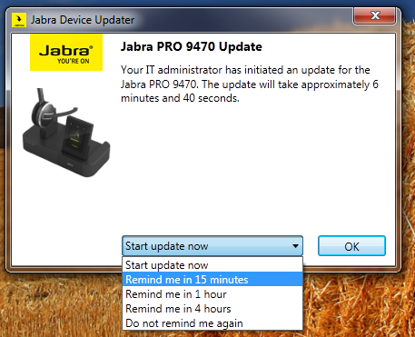
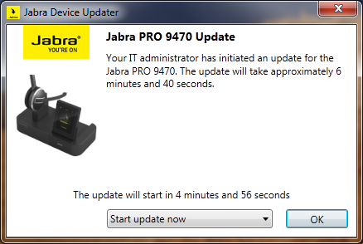
END-USER INFORMATION
If IT admin has set parameters in MSI package
“Allow user to postpone update”
“Allow user to reject update”

Slide 37
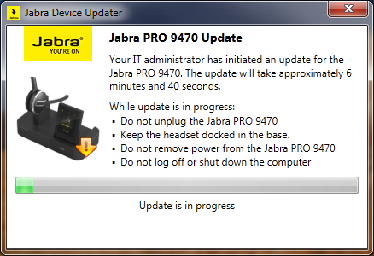
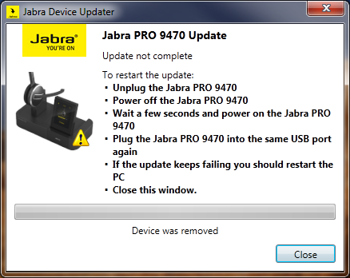
FIRMWARE UPDATE END-USER INFO
Jabra Device Updater end-user information when updating Jabra device
Recovery instructions to end-user in case of unintended Device Firmware Update (DFU) mode interrupt

Slide 38
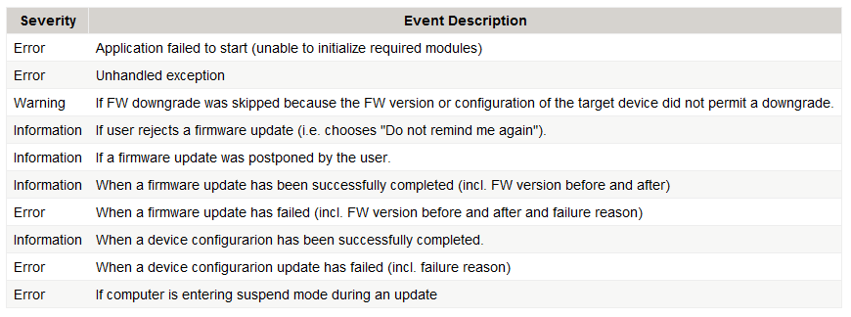
JABRA XPRESS DIAGNOSTIC OPTION
Jabra Device Updater logs major events to Windows' Application Log.
The log source is called "Jabra Device Updater".
The table below shows an overview of logged events.

Slide 39
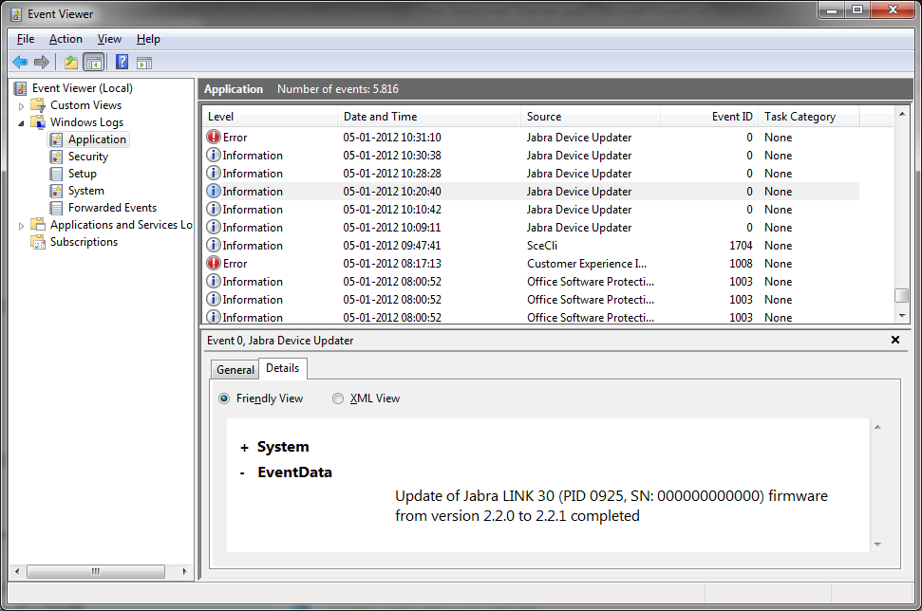
REPORTING IN WINDOWS EVENT LOG

Slide 40
IT ADMINISTRATORS WEB PAGE
PLEASE VISIT: www.jabra.com/xpress

Slide 41
YOUR BUSINESS OPPORTUNITY ELEVATOR PITCHES

Slide 42
JABRA XPRESS - WHAT’S IN IT FOR YOU? 3 BUSINESS OPPORTUNITIES
1
2
3
DOOR OPENER/QUALIFIER FOR UC PITCH TO GLOBAL ACCOUNTS AND/OR CC CUSTOMERS
MORE HARDWARE SALES OPPORTUNITIES
BUILD CUSTOMER LOYALTY
Jabra Xpress maximizes your customers’ headsets ROI
by remotely deploying, managing and updating audio devices in record time.
Pitch the end-to-end Intelligent audio solution from Jabra
You can offer your customers:
Jabra Xpress starts to add real value for customers with 50+ USB headsets. More headsets, more softphones, and more Jabra Xpress plays a significant role enhancing users experience and productivity, which smoothens and accelerates UC adoption.
All users get their headsets configured to their specific needs and fully up-to-date – all at once.
IT Adm. gain in efficiency – they save time and take full control of all Jabra USB devices
Superior audio quality for greater user experience
Plug and Play solution MS or CISCO certified for seamless system integration
Future proof solutions by adding Jabra Xpress for customers’ investment protection and faster ROI

Slide 43

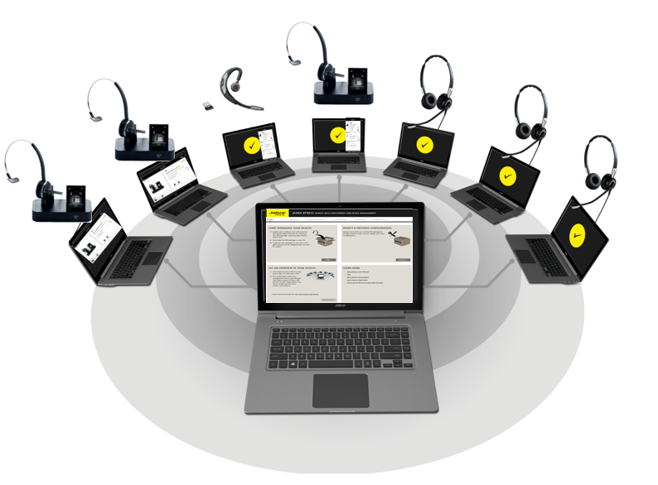
WHAT’S IN IT FOR INFORMATION TECHNOLOGY ADMINISTRATORS? SIMPLICITY – MORE CONTROL – HIGHER EFFICIENCY
Jabra Xpress is an online service designed for IT professionals to remotely mass deploy & manage Jabra USB headsets in record time.
A SERVICE THAT:
Simplifies & accelerate IT management tasks
Gives IT greater control of Jabra audio devices
Enables IT to gain higher efficiency
KEY BENEFITS
HOW? WITH A SET OF SMART TOOLS ENABLING:
Faster UC adoption
Enhanced user satisfaction & productivity
Maximized headsets ROI
EASY DEPLOYMENT – 2 options for extended flexibility
SMART ASSET MANAGEMENT – incl. diagnostics & reporting tools
AGILE MAINTENANCE - incl. settings, change of settings, firmware updates

Slide 44

MARKETING GO-TO-MARKET RECOMMENDATION

Slide 45
HOW TO RAISE THE JABRA XPRESS LEVEL OF ENGAGEMENT?
ADDRESS IN KEY MESSAGING “IT PAIN POINTS”
SELL THE COMPLETE JABRA SOLUTION
ITDMs WANT TO:
Have control
Save time
Have tools that simplify their tasks
Decrease the number of ticket/calls related to devices
Don’t sell Jabra Xpress as a standalone service, but as an integrated part of the sales pitch.
Wrap up your Jabra sales pitch with Jabra Xpress.
Offer your customers a complete Jabra intelligent audio solution with Jabra Xpress - an online service INCLUDED.
MAKE IT SIMPLE!

Slide 46

COMMUNICATION RECOMMENDATION
PITCH THE END-TO-END INTELLIGENT AUDIO SOLUTION FROM JABRA AND OFFER YOUR CUSTOMERS:
JABRA SOFTWARE & SERVICES FOR PROFESSIONALS TO GO THE EXTRA MILE AND PERFORM AT THEIR BEST
Superior audio quality – for a greater user experience
A solution based on standard Microsoft technology*, for seamless system integration
Future proof solutions by adding Jabra Software/services - for customers’ investment protection and faster ROI
ADD JABRA XPRESS TO:
Simplify IT management task & accelerate UC adoption
Gain control & enhance user satisfaction and productivity
Gain higher efficiency & maximize headset ROI

Slide 47

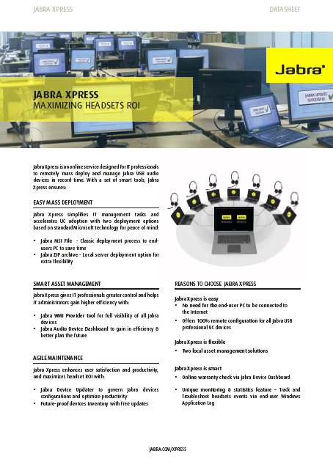
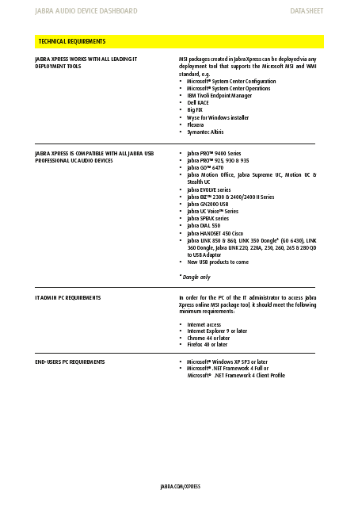
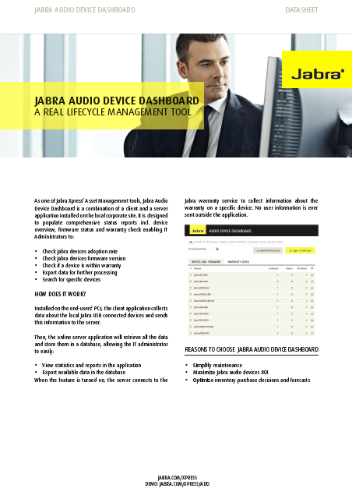
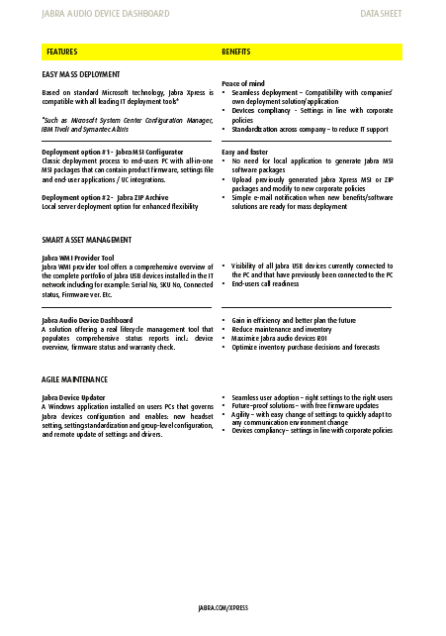
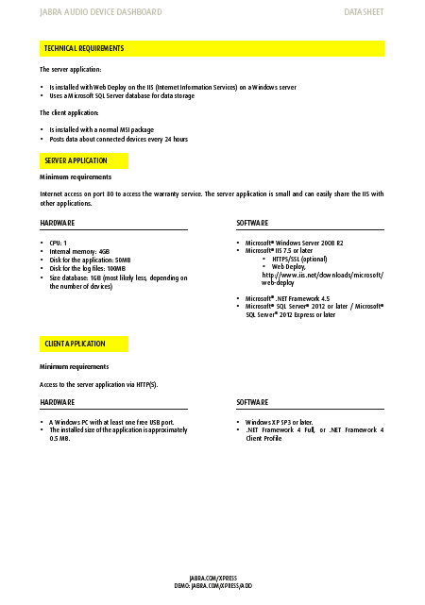

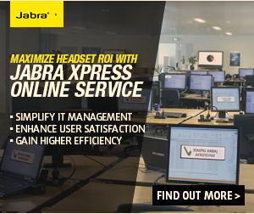

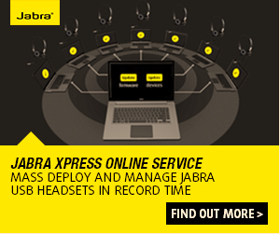
MARKETING DELIVERABLES AT YOUR DISPOSAL
JABRA XPRESS PRESENTATION
DATASHEETS
Jabra Audio Device Dashboard Datasheet
Partner PPT – incl. elevator pitch
Jabra Xpress Datasheet
ADDRESSING IT ADMINISTRATORS
1x banner (300X250)
1x banner (728X90)
2x banners
(300x250 – 160x600)
JABRA XPRESS
GENERIC

Slide 48

THANK YOU

